Slide 1
Causal effect of the Great Recession on Unemployment across the Unites States of America
Team Members
Karthik Anbazhagan (kartanba)
Shailendra Patil (patilsh)
Ankit Saxena (ansaxena)

Slide 2
What is the Great Recession?
A sharp decline in the global economic activity during the late 2000s.
In the US, the recession lasted from December 2007 to June 2009.
Reason for the recession:
The US housing market crash
Effects on the US economy:
GDP declined by 0.3% in 2008 and 2.8% in 2009
Unemployment rate touched 10%

Slide 3
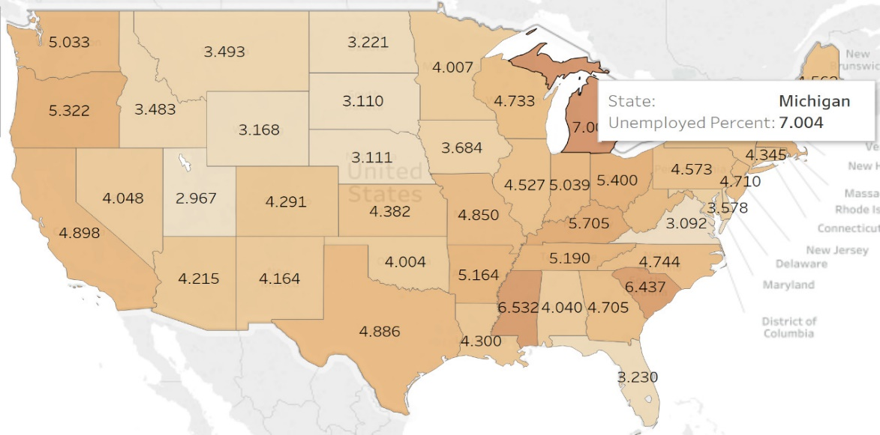
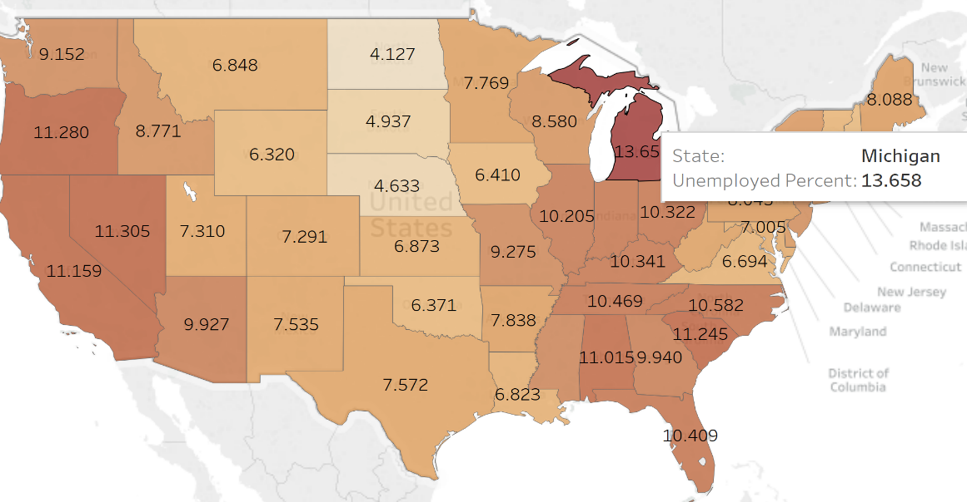

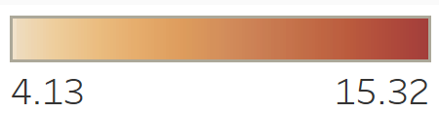
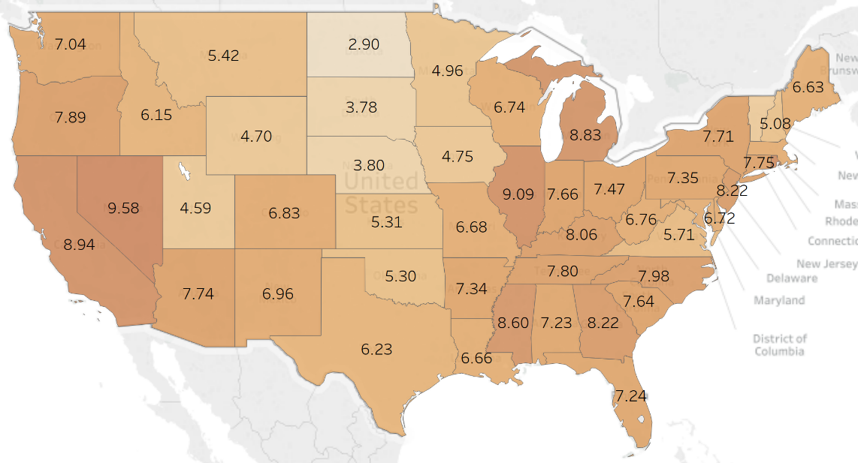
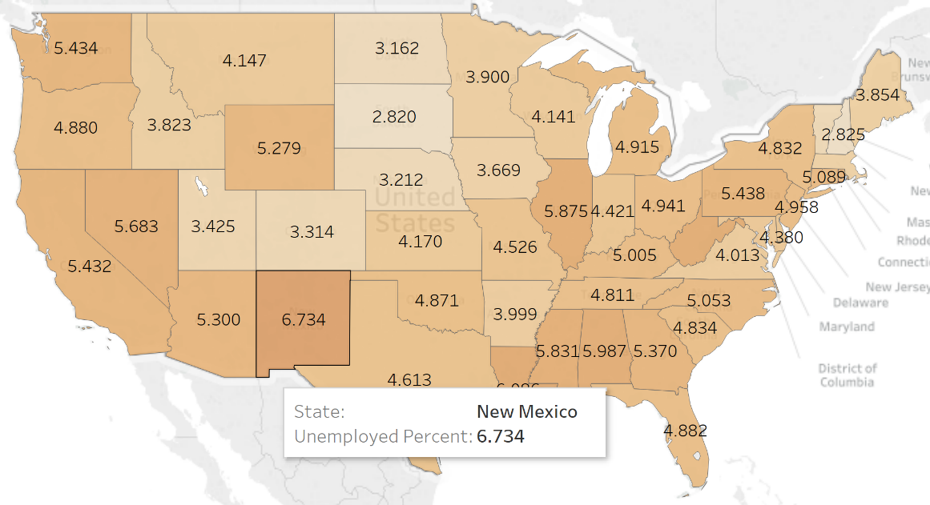
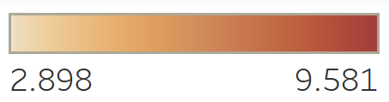
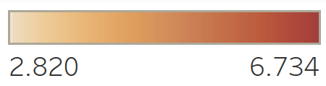
Unemployment Rate (%)
2006
2009
2013
2016

Slide 4
Motivation
"A poll showed 57 percent of surveyed American adults believed the United States was still in a recession" - NBC News/Wall Street Journal, 2014
“53 percent of Republicans think the unemployment rate has risen under Obama” – The Washington post
“In 2015, six years from the end of the recession, total U.S. employment was 148 million compared to a pre-recession peak of 146 million. Meanwhile the population of working age people rose by 17.5 million, far more than the 1.7 million employment gain” – Forbes

Slide 5
Why is it interesting?
MYTH: The U.S. recovery is unusually slow
FACT: The current U.S. recovery is outpacing recoveries of other advanced economies
MYTH: The declining unemployment rate is a “big lie.”
FACT: The unemployment rate over the past year and a half is on the decline and is almost entirely due to job growth, as labor force participation has increased.
A lot of misconceptions about the post-recession recovery.
Based on our study we found that a lot of them are false.

Slide 6
Relevant Existing Work
Mapping the “Great Recession” – Dabrownstein.com
BLS is the principal Federal agency responsible for measuring labor market activity, working conditions, and price changes in the economy. - BLS
Unemployment Compensation Benefits During the Great Recession: Recipients and Their Post-Claim Outcomes - Mathematica Policy Research
International Price program: Import and export price changes revised every 3 months – The Economic Daily
Measure employment and unemployment, compensation, worker safety – Commissioner’s Corner

Slide 7
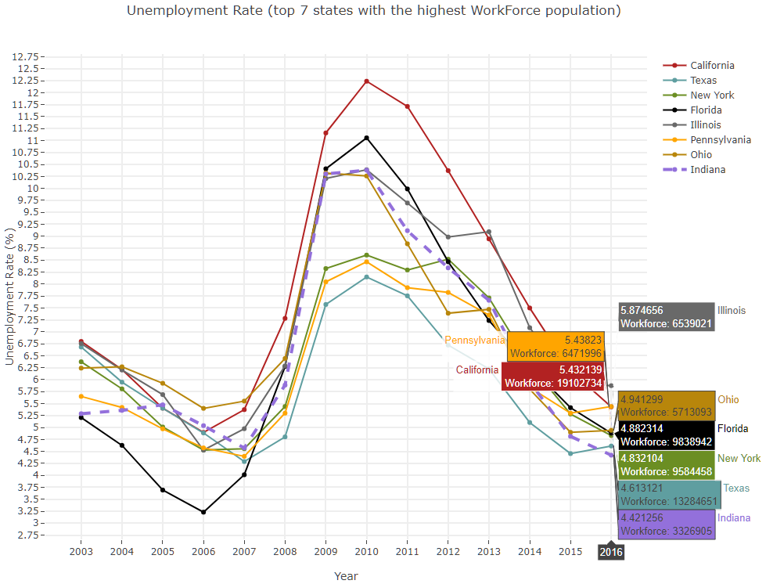
How were the unemployment rates affected across the states?

Slide 8
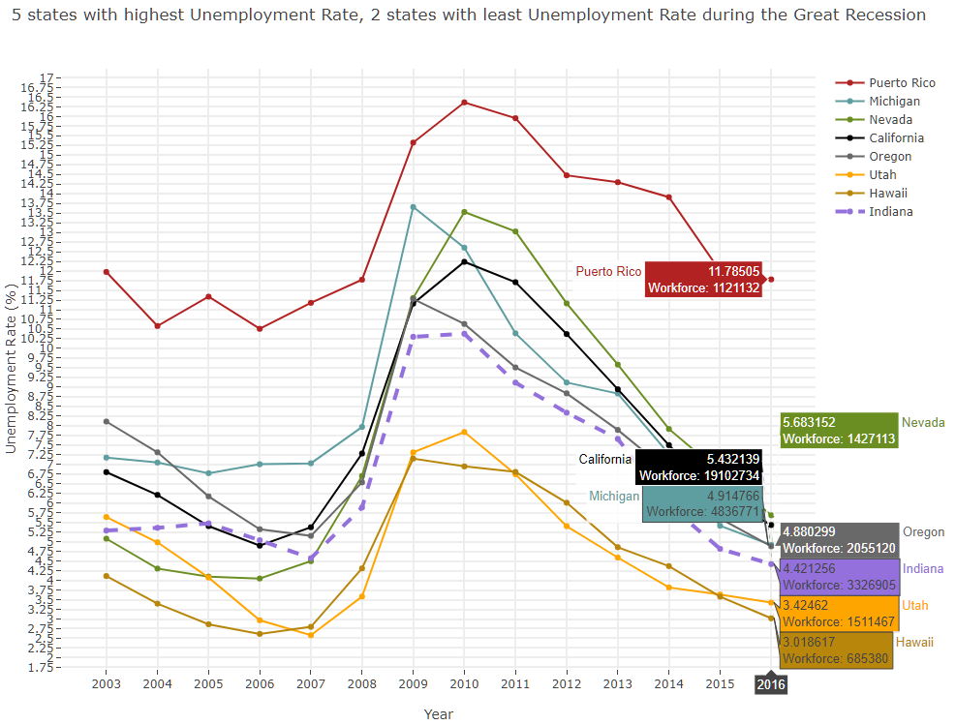
How were the unemployment rates affected across the states?

Slide 9
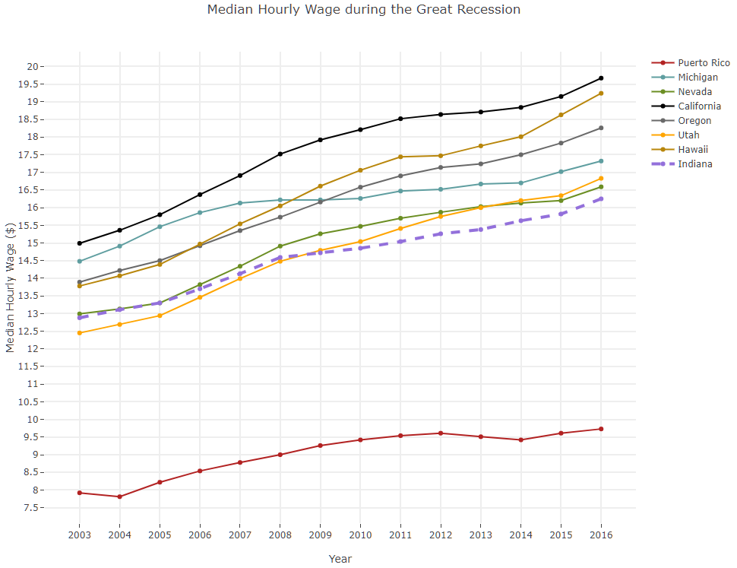
How were the hourly wages affected across the states?

Slide 10
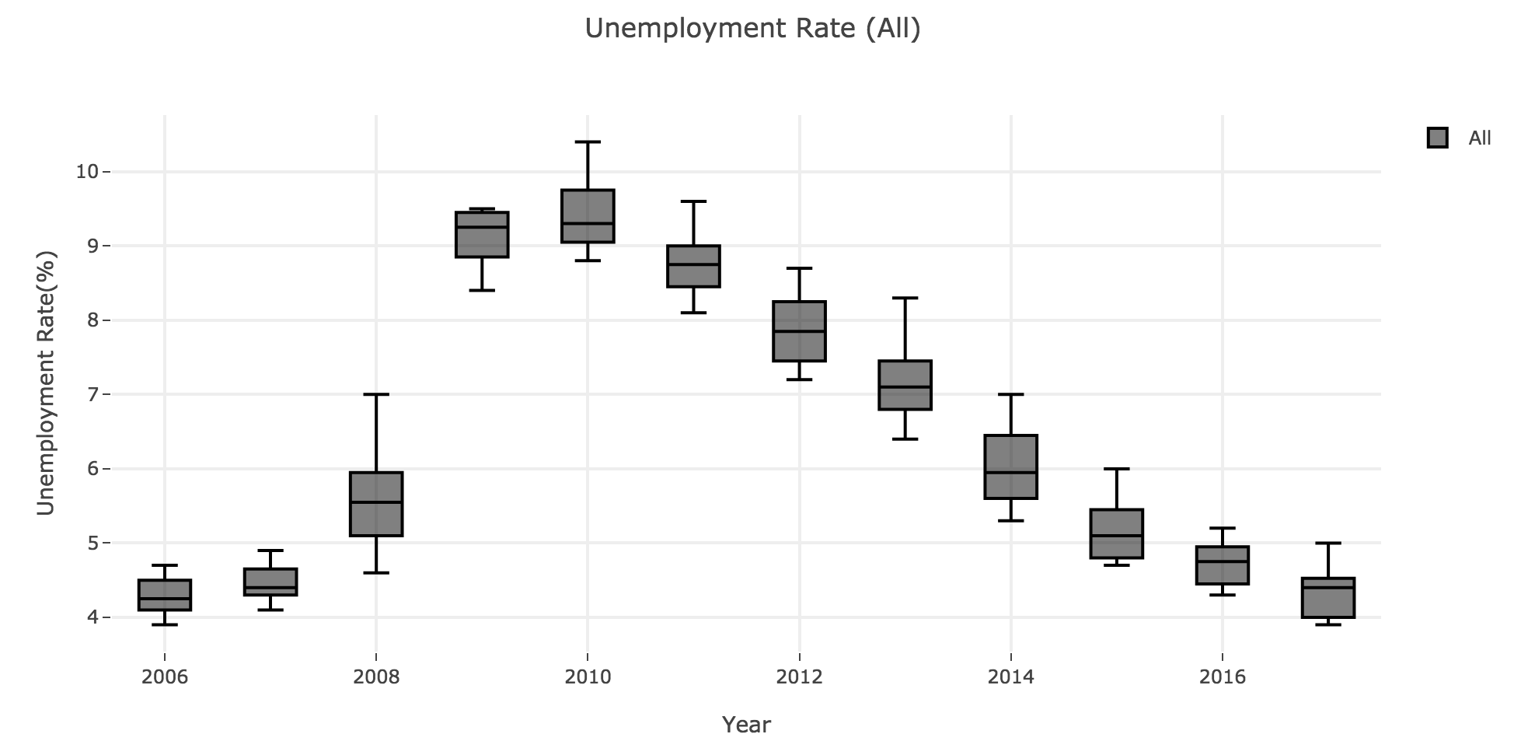
How were the unemployment rates affected by gender?
Drastic increase in the rate of unemployment from 2008
Unemployment Rate started to improve from 2011

Slide 11
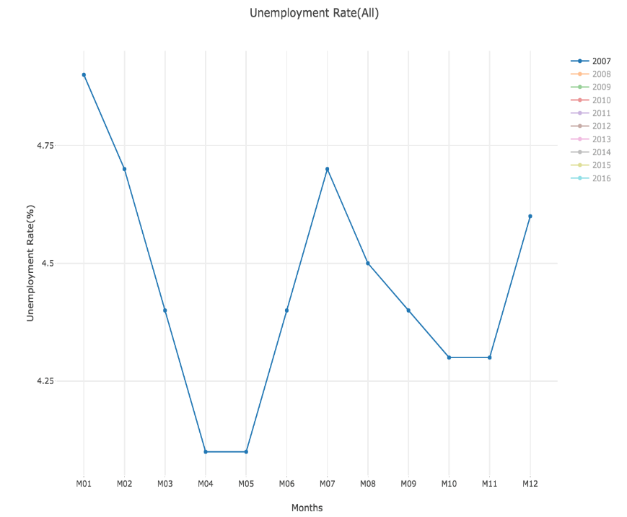
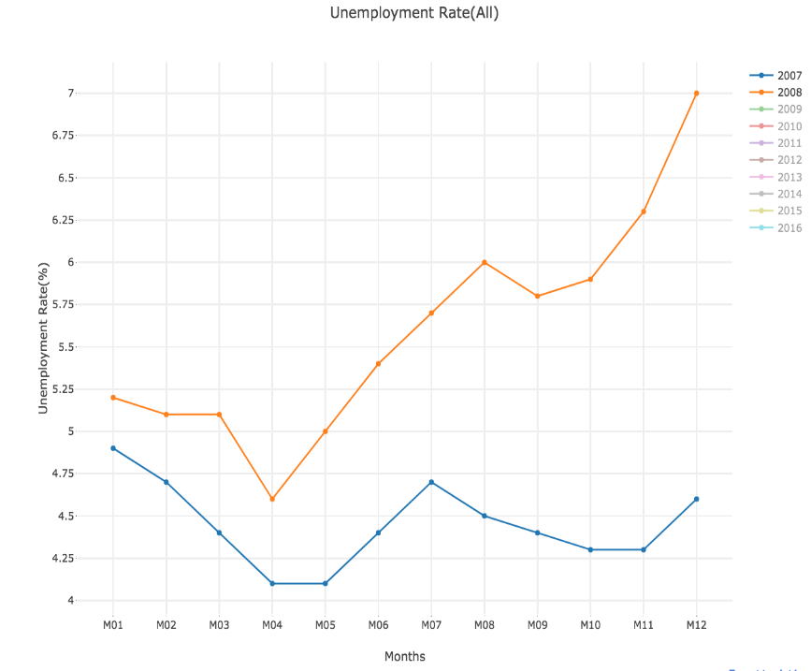
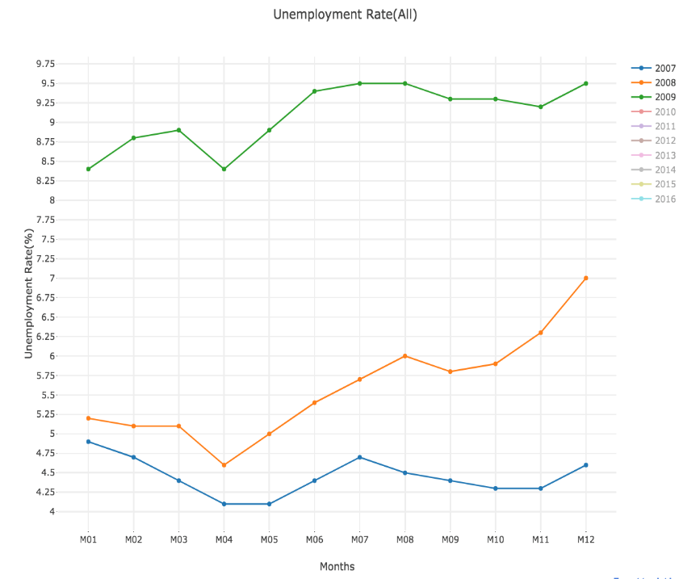
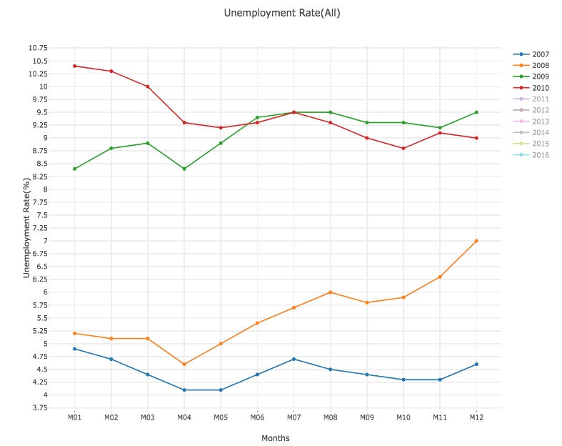
GRAPHS SHOWING THE INCREMENT IN UNEMPLOYMENT RATE

Slide 12
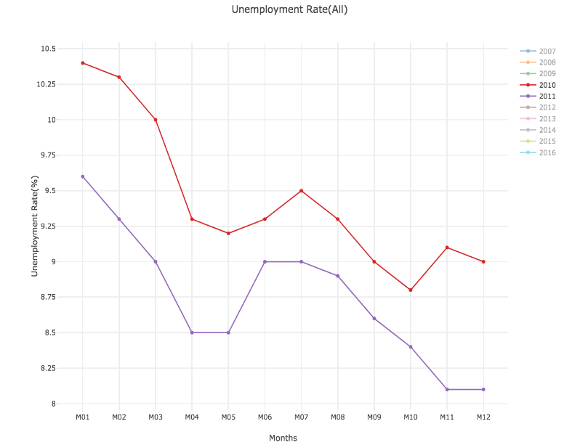
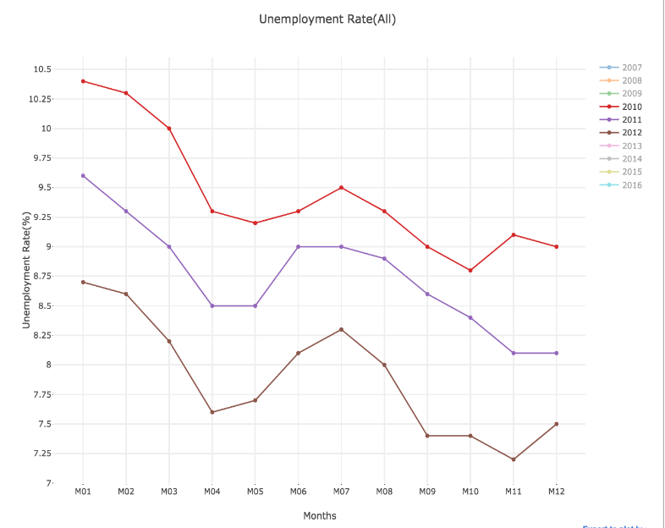
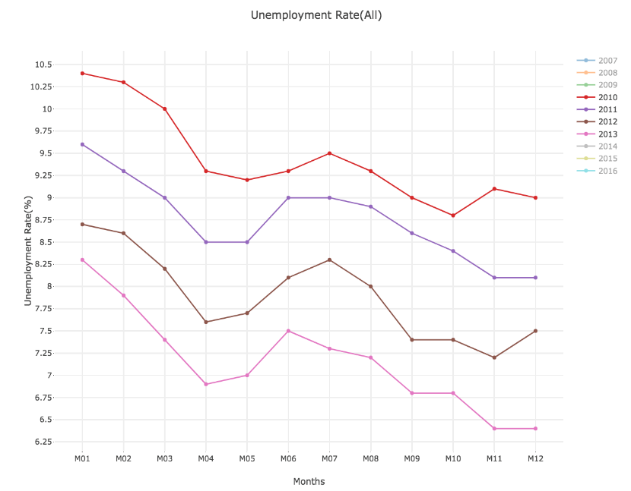
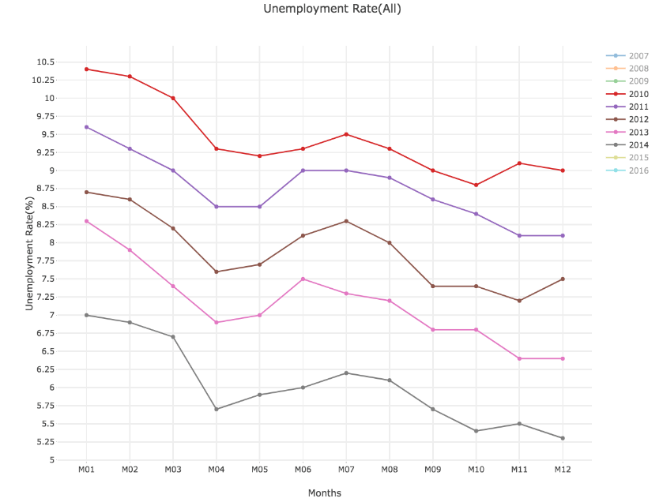
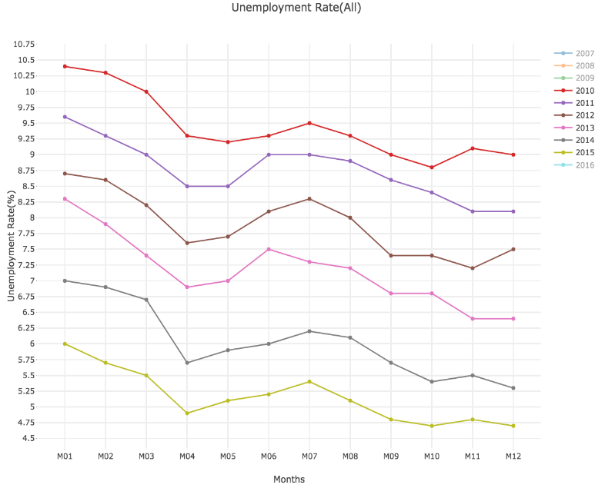
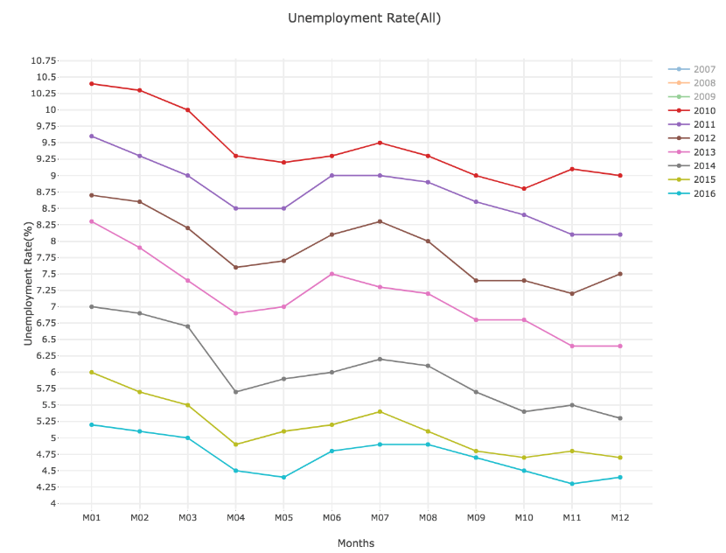
GRAPHS SHOWING THE DECREMENT IN UNEMPLOYMENT RATE

Slide 13
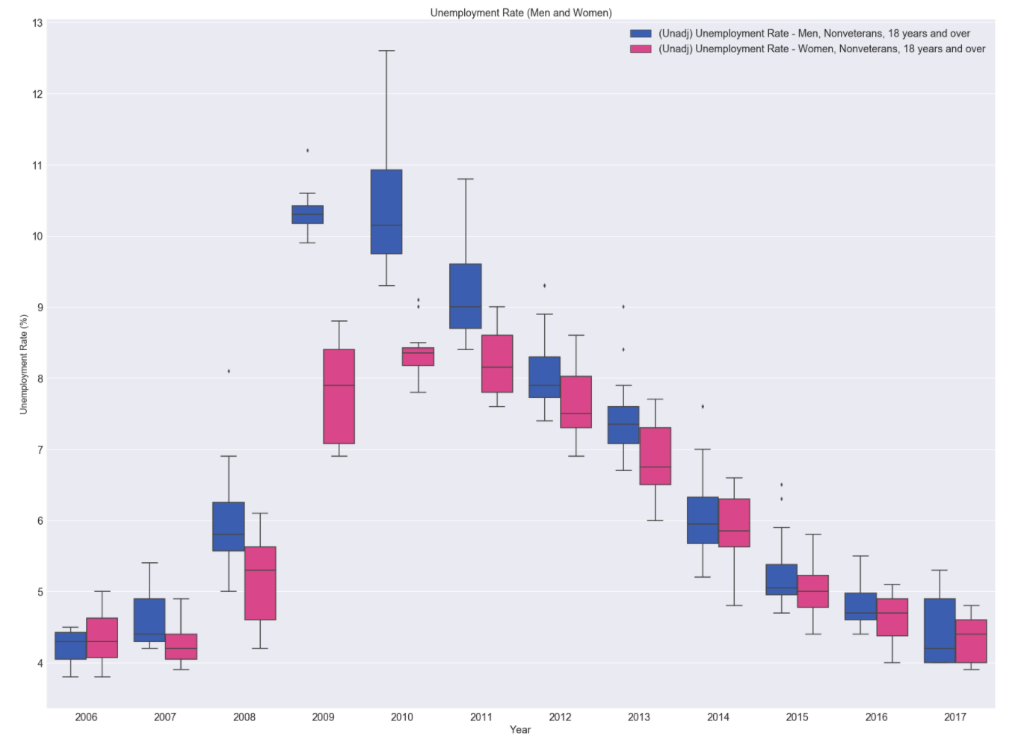
Unemployment Rate for Men and Women
2006 and 2007 , unemployment rate for both men and Women are nearly equal.
As seen, unemployment rate of men has significantly increased compared to Women

Slide 14
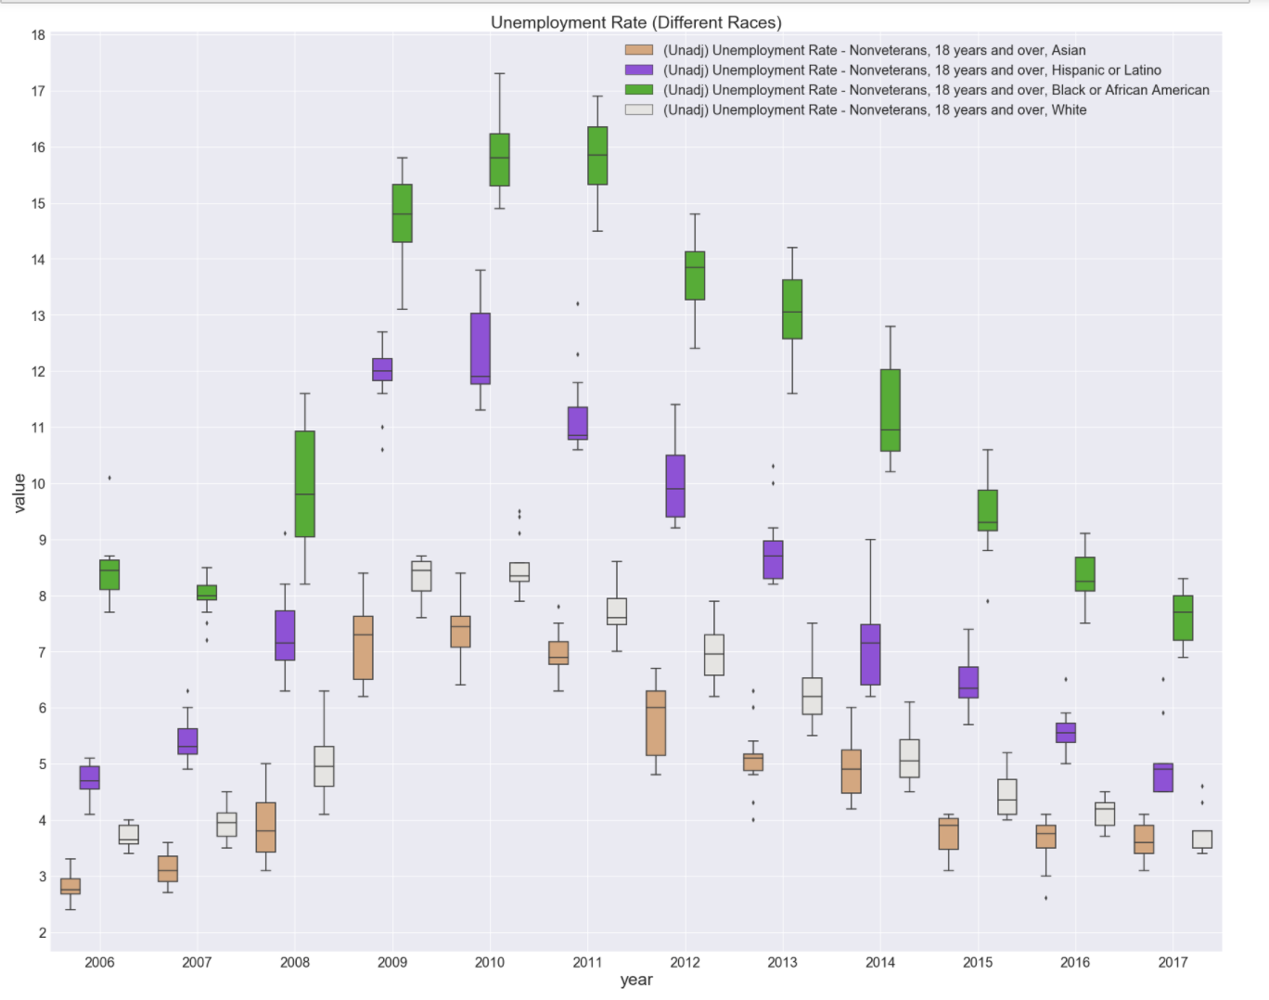
How were the unemployment rates affected by ethnicity?

Slide 15
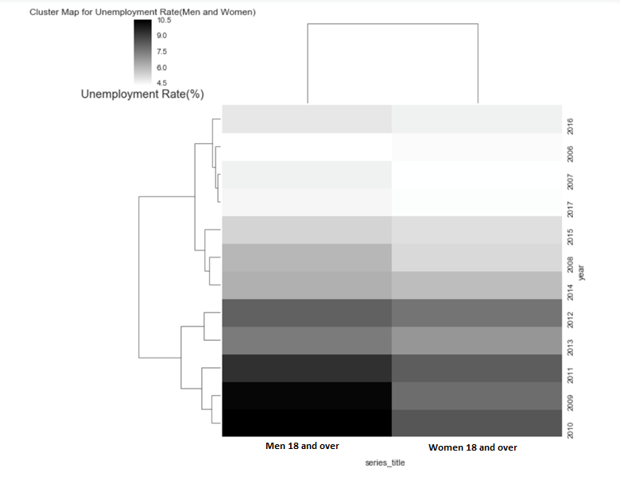
Cluster Map of Unemployment Rate For Men and Women
The cluster map forms cluster based on unemployment rate .
As seen from the graph , for Men the highest unemployment rate is in Year 2009, 2010 and the lowest is in the year range 2016, 2017, 2006, and 2007.
As seen from the graph , for Women the highest unemployment rate is in Year 2009, 2010 and the lowest is in the year range 2016, 2017, 2006, and 2007.

Slide 16
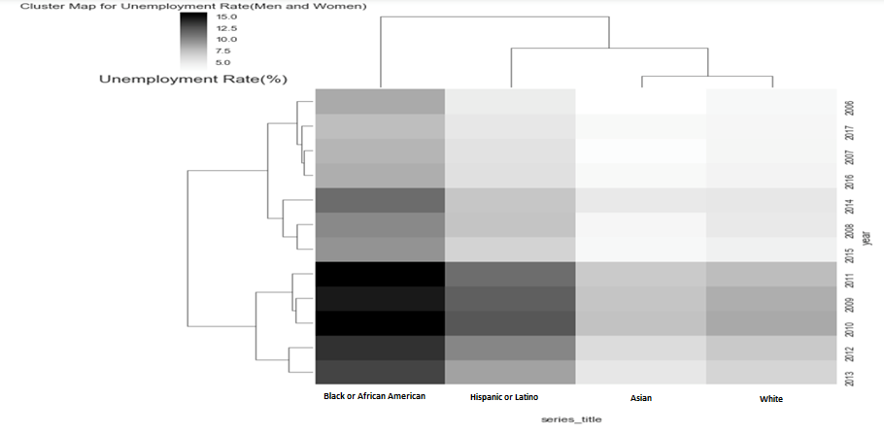
Cluster Map of Unemployment Rate for Different Races

Slide 17
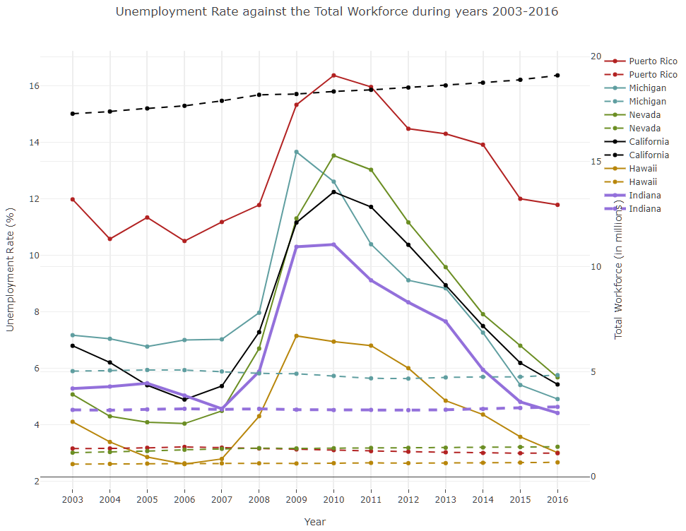
How was the job market during and post Great Recession period?

Slide 18
Insights
May 2014 marked the recovery of all jobs lost during the recession. About 12 million jobs created since job losses stopped in Feb 2010.
Employment losses in the Great Recession were greater among men and the young.
Wage increases began to slide in 2007. In 2009, in the midst of the Great Recession, salaries decreased 1.6 percent. However, by 2016, the salaries rebounded and experienced growth close to 16%.
The size of the state correlates to the size of the local economy:
California (2.8% employment change)
Texas (2.5% employment change)
Florida (2.9% employment change)
Georgia (2.4% employment change)
North Carolina (2.1% employment change)

Slide 19
Insights
May 2014 marked the recovery of all jobs lost during the recession. About 12 million jobs created since job losses stopped in Feb 2010.
Employment losses in the Great Recession were greater among men and the young.
Wage increases began to slide in 2007. In 2009, in the midst of the Great Recession, salaries decreased 1.6 percent. However, by 2016, the salaries rebounded and experienced growth close to 16%.
The size of the state correlates to the size of the local economy:
California (2.8% employment change)
Texas (2.5% employment change)
Florida (2.9% employment change)
Georgia (2.4% employment change)
North Carolina (2.1% employment change)

Slide 20
Future Work
Unemployment affects the society as a whole:
GDP: Unemployment affects industrial production output which affects the GDP.
Health issues: The overall unemployment scenario can dramatically increase general health issues of individuals.
Divorce rates: Quarrels and arguments at home front which may lead to tension and increased numbers of divorces.
Crime and violence: Increase in the rate of crime.
Suicide cases: Increase in the rate of suicides.

Slide 21
Thank You

